Slide 1

Dynamic-Code-Company
“CODE THE FUTURE,TODAY”
DATE: 08 AUG 2024
Prajapati Mohit
Doshi Perak
Patel Mayur
Seeft semi

Slide 2
TOPICS
Introduction
Problem
Solution
Market Opportunity
Business Model
Traction
Go-to-Market Strategy
Competition
Financial Projections
Team
Funding Ask

Slide 3
Introduction
Dynamic-Code-Company is at the forefront of transforming the software development landscape through innovative automation solutions. Founded in [2024], our company specializes in providing cutting-edge tools that simplify and accelerate the coding process, helping developers deliver high-quality software faster and more efficiently.
Our Mission: To revolutionize software development with automation tools that reduce repetitive tasks, enhance productivity, and enable developers to focus on creative problem-solving.

Slide 4
Problem
1. Problem Statement
Clear Definition: Briefly describe the core problem that your company addresses. For example, “Developers face significant challenges with inefficient coding processes that lead to wasted time, increased error rates, and higher costs.”
2. Pain Points
3. Market Data & Statistics
Quantify the Problem: Use data to illustrate the scale and impact of the problem. For example:
“According to a recent industry report, 60% of software development time is spent on debugging and testing.”
“Companies lose an average of $1.5 million per year due to software bugs and inefficiencies.”
4. Real-World Examples
Case Studies or Anecdotes: Provide specific examples or anecdotes that illustrate the problem. For example:
“A major tech firm reported a 30% increase in development costs due to inefficiencies in their coding process.”
“Developers at XYZ Company spend an average of 20 hours per week on manual testing, impacting their productivity.”

Slide 5
Solution
Solution Overview
Key Features
Benefits
Value Proposition
Visual Elements

Slide 6
Solution Overview
“Dynamic-Code-Company offers an advanced automation platform that streamlines code generation and testing, helping developers reduce manual effort and enhance productivity.”

Slide 7
Key Features
“Real-time code analysis highlights potential errors and suggests improvements as you code, preventing issues before they arise.”

Slide 8
Benefits
Improved Code Quality: Explain how your solution enhances the quality of the software. For example, “Real-time feedback and automated testing reduce the number of bugs and improve overall software reliability.”
Increased Efficiency: Highlight how your solution saves time and reduces manual effort. For example, “Developers can save up to 40% of their time by automating routine tasks and focusing on more complex aspects of their projects.”

Slide 9
Value Proposition
Unique Selling Points: Summarize what makes your solution stand out from alternatives. For example, “Dynamic-Code-Company’s platform offers unmatched accuracy in code generation and analysis, powered by our proprietary algorithms and AI technology.”

Slide 10
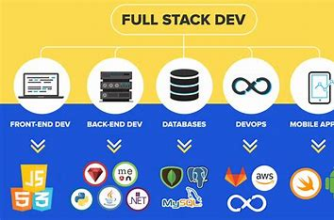
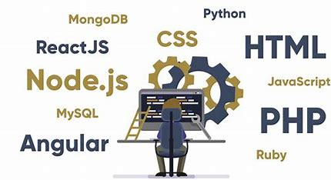

Visual Elements
Include screenshots or a brief demo of your product in action.

Slide 11
Market Opportunity
Market Size
Market Growth
Target Market
Market Validation
Competitive Landscape

Slide 12
Business Model
Revenue Streams business model in Dynamic-Code-Company
Dynamic-Code-Company
Product Sales
Usage-based Billing
Professional Service
Training & Support

Slide 13
Pricing Strategy
Market Research
Cost Analysis
Pricing Model
Sales Training
Value Proposition
Customer Feedback
A
B
C

Slide 14
Customer Acquisition
Customer Acquisition
Customer Support
Cost Analysis
Communication
Collaboration

Slide 15
Cost Structure
Cost-Based And Value-Based Pricing
Break-Even-Point
Fixed Cost
Classification
Cost Control
Allocation

Slide 16
Profitability
Revenue Growth
Pricing Strategy
Value base & Dynamic
Profitability Metric
Financial Planning And Analysis
Risk Management

Slide 17
Traction

Slide 18
Go-to-Market Strategy
Target Market
Market Entry Plan
Sales and Distribution Channels
Marketing and Promotion

Slide 19
Competition
Competitive Analysis
Feature Comparison: Create a comparison table or matrix highlighting key features or benefits of your product versus those of your competitors.
Strengths and Weaknesses: Summarize the strengths and weaknesses of each competitor. Include factors like product quality, pricing, customer service, and market presence.

Slide 20
Financial Projections
Software
Licenses
Profit and loss
Service Contracts

Slide 21

Team
NAME: PRAJAPATI MOHIT
Roles and Responsibilities: CEO AND HR
Education: Diploma in CSE

Slide 22

NAME: DOSHI PRERAK
Roles and Responsibilities: MANAGER
Education: Diploma in CSE

Slide 23

NAME: SEEFAT SAMI
Roles and Responsibilities:Softwere Developer
Education: Diploma in CSE

Slide 24

NAME: Mayur Patel
Roles and Responsibilities:SR. Manager
Education: Diploma in CSE

Slide 25
NAME: HARSH DHINGRA
Roles and Responsibilities:Engineer
Education: Diploma in CSE

Slide 26
Funding Ask

Slide 27
THANKS

